Slide 1


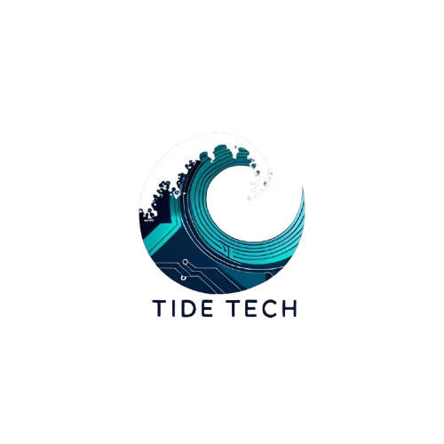

Eco-Fishing Score – Track Your Trip. Change the Tide
A smart way to measure the environmental impact of your fishing trip.
Problem Statement:-
Overfishing and unsustainable gear use are damaging marine ecosystems.
There’s no tool to help people understand their trip’s impact — until now.
Team Name:-
Tide Tech
Team Members:-
Rithikaa V
Sanjay Krishnan K
Samyukta R
Sagin Aadith M

Slide 2
Our Solution:-
Empowering every fishing trip to be a step toward ocean sustainability.
Eco Score Calculation
Based on gear used, species caught, and catch quantity.
Real-Time Eco Feedback
Get smart tips from the Eco Coach to improve sustainability.
Earn Badges & Certificates
Unlock achievements and download eco-friendly certificates.
Track Progress Over Time
View your improvement with charts, maps, and milestones.
Trip Impact History
See detailed records of your fishing trips and their impact.
Promote Ocean Sustainability
Make every fishing trip a step toward protecting marine life.

Slide 3
TECH STACK:-
Powered by Modern Web & Cloud Tech
Frontend:-
Backend:-
Design + Tools:-
HTML / CSS / JavaScript – Responsive, interactive UI
Leaflet.js – Map trip locations
Chart.js – Visualize Eco Score trends
jsPDF – Download eco-certificates
Firebase Authentication – Secure user login
Firestore Database –Store trips, scores, badges
Firebase Hosting –Fast, reliable app hosting
Google Fonts & FontAwesome – Clean UI styling
Figma / Canva – Design & branding assets
GitHub –Code management & collaboration

Slide 4
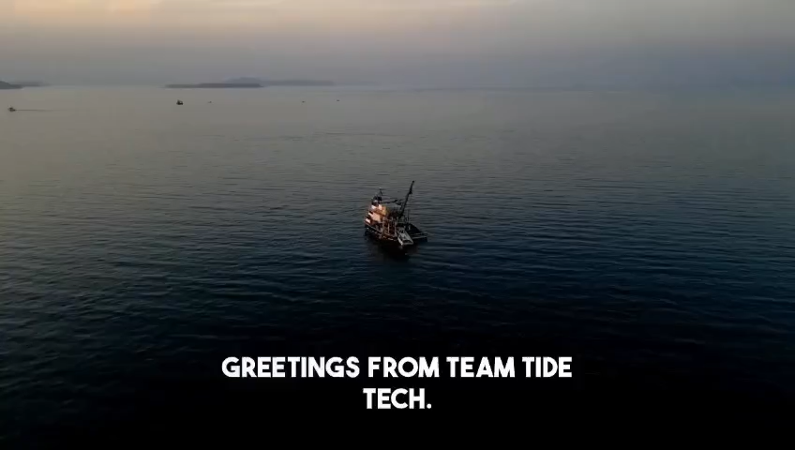
YOUTUBE DEMO VIDEO:-
https://www.youtube.com/watch?v=OurRneaBKN8
Watch how our system calculates Eco Scores and delivers real-time feedback

Slide 5
Making Marine Conservation Measurable
Businesss Impact:-
Scalability:-
Promotes sustainable fishing brands and gear through partnerships, enabling eco-labeling and certification opportunities.
Builds trust and brand value among eco-conscious users, NGOs, and government agencies promoting marine conservation.
Easily scalable globally by integrating region-specific species and gear databases.
Expandable features like user leaderboards, trip tracking, and integration with fishing apps can grow user engagement and market reach.

